Slide 1

V.2.G.
Reimagined w/BlockCHAIN
Team Bolton

Slide 2
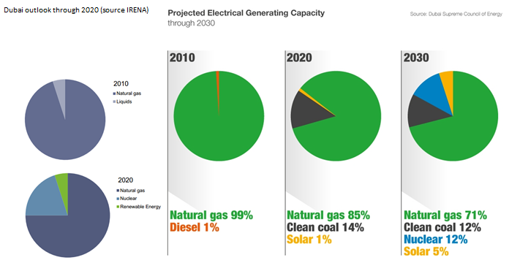
The Market
We rely massively on non-renewable energy sources
Natural Gas is a major source of energy
What if the average person could contribute to a more sustainable future?
Do you want to be part of the change?

Slide 3
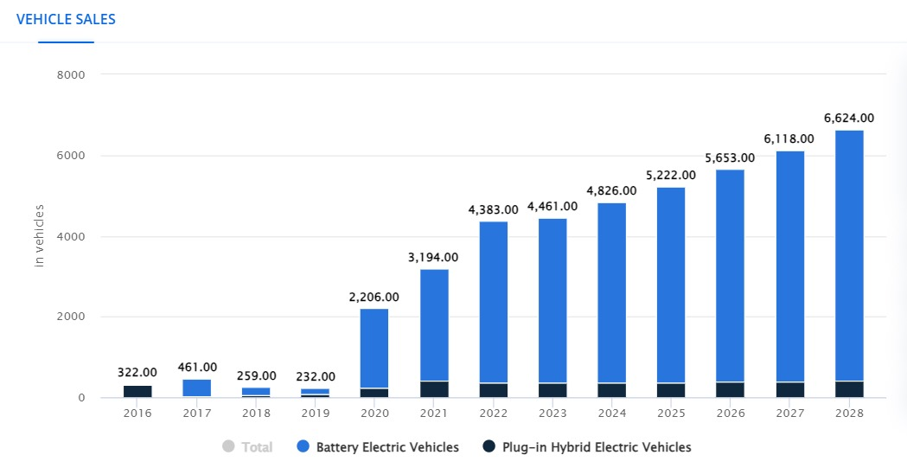
Trend of EV Sales
The data shows the trend of Mass Adoption of EVs in the UAE
They are an untapped resource
A massive network of Energy Reservoirs
Vehicles will be left plugged in overnight at home and during daytime at work
Smart EVSEs will act as decentralized nodes for bi-directional transmission

Slide 4
The Problem
Inconsistency In Renewable Power causes fallback to natural gas
Full reliance on Renewables requires power storage

Slide 5


Incentives & Beyond
Providing a Token exchangeable for a new vehicle or a battery pack
Reminding users of the impact they make
The carbon emissions they prevent
The monetary gains they can tap into

Slide 6
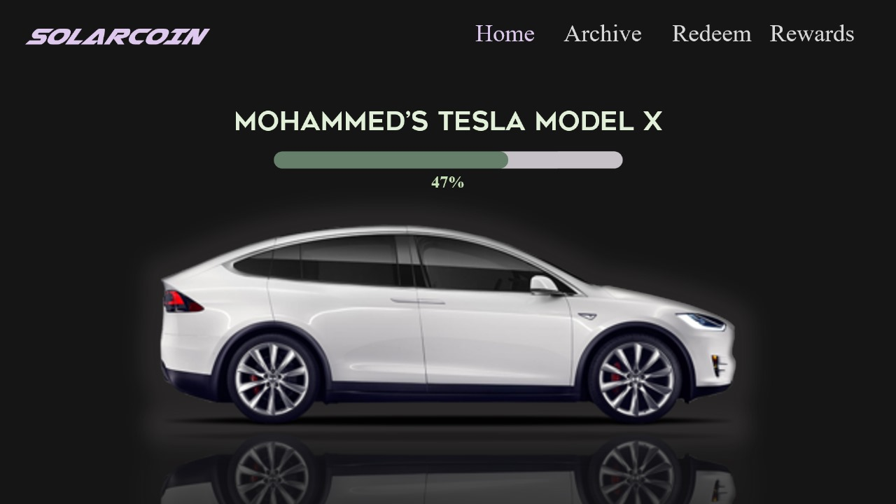

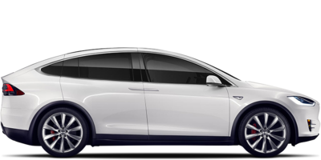
SOLARCOIN
Home Archive Redeem Rewards
MOHAMMED’S TESLA MODEL X
47%

Slide 7
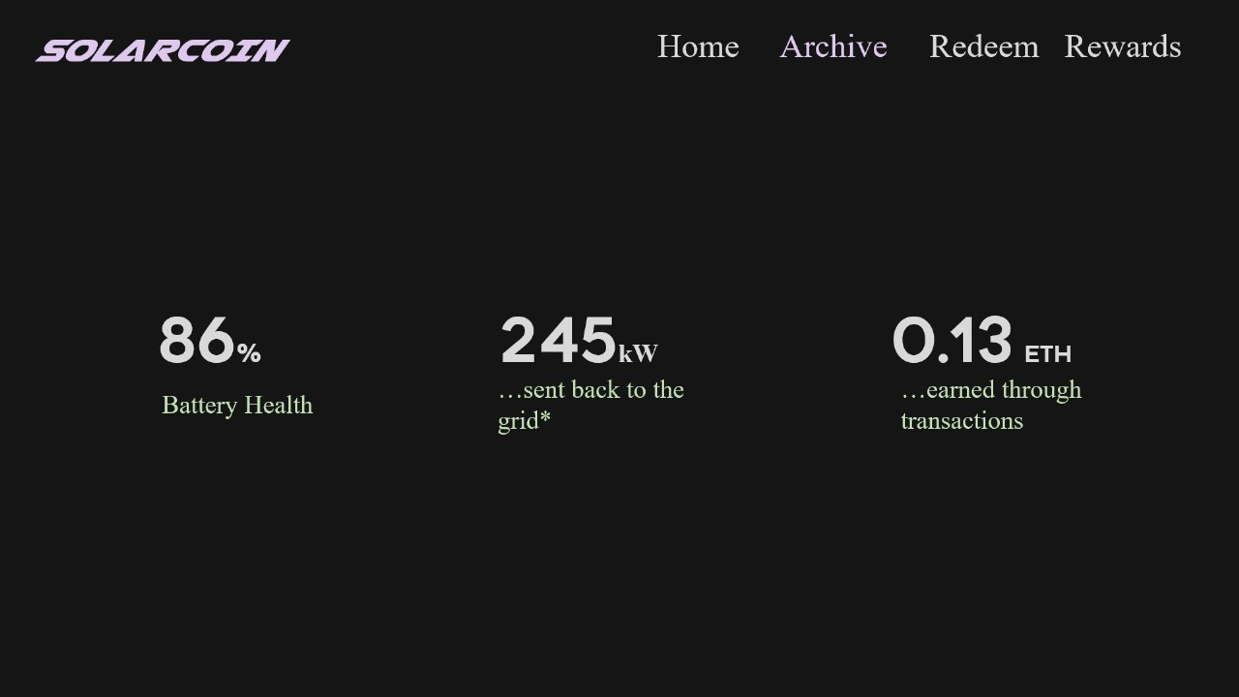
SOLARCOIN
Home Archive Redeem Rewards
86%
245kW
0.13 ETH
…sent back to the grid*
…earned through transactions
Battery Health

Slide 8
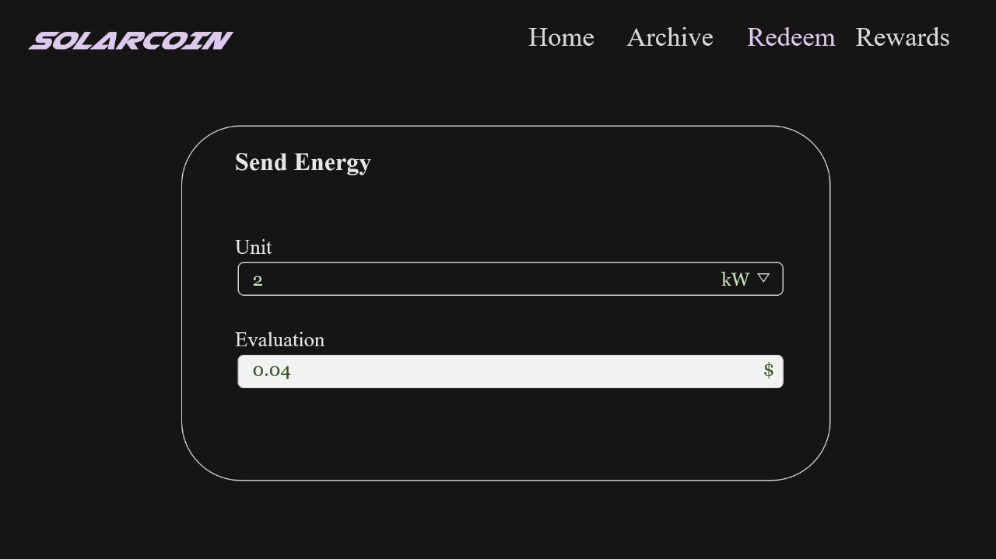
SOLARCOIN
Home Archive Redeem Rewards
Send Energy
Unit
2 kW
Evaluation
0.04 $

Slide 9
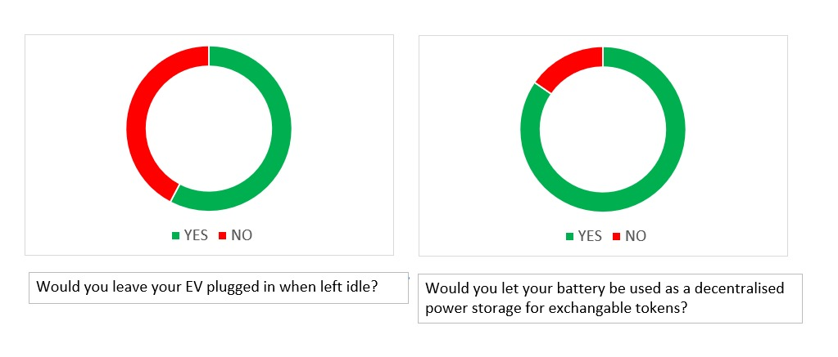
Why Start with Decentralized Energy Storage?
Meeting cop23 Goals
LOCAL MARKET
The quicker we adopt EVs, the quicker we are to meet our Carbon Emission Goals
Breaking the reliance on carbon-heavy natural gas
Allows a bigger part of the country to contribute
As the number of vehicles owned greatly exceed people that can generate power

Slide 10

Thank You

